Slide 1

Pivotal Cloud Foundry
Workshop Introduction
Pivotal and Perficient
April 2018

Slide 2
Welcome
Thanks for participating and taking time out of your week to join us!
Serving breakfast, lunch, refreshments
Lots happening today
Lectures
Cloud Native Architecture
Pivotal Cloud Foundry
Spring Boot, Spring Cloud Data Flow
Labs
Pairing to work together
Send email to cbusch@pivotal.io to be added to the Pivotal Web Service tenant
From Pivotal and Perficient teams

Slide 3
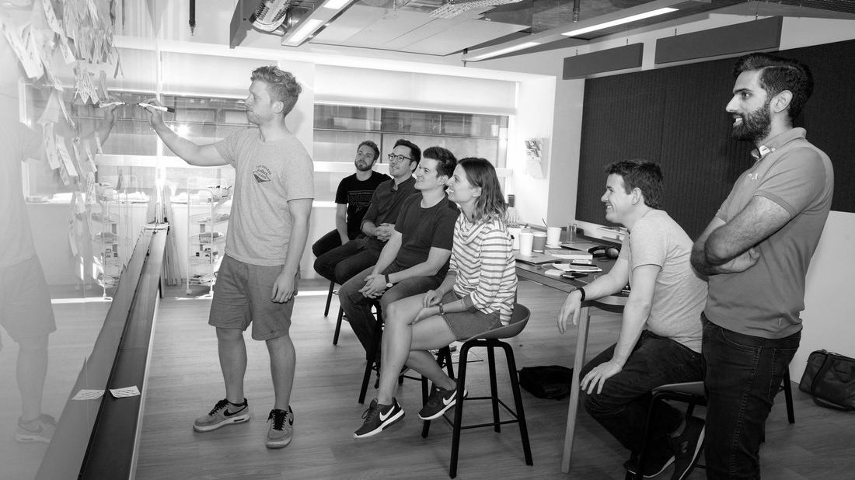
Team Introductions

Slide 4
Overview with Jim Lyon
PIVOTAL

Slide 5
Overview with Jason Hudnall
PERFICIENT

Slide 6
Let’s get going…

Slide 7
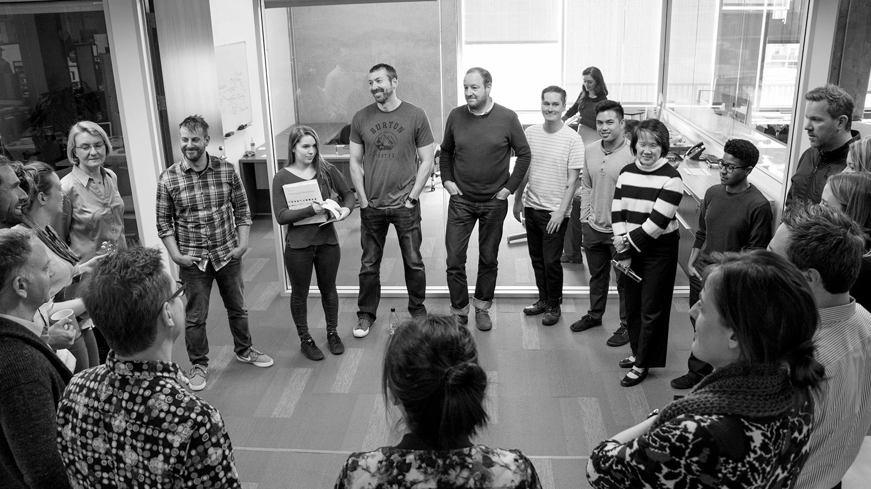
Transforming How The World Builds Software
© Copyright 2018 Pivotal Software, Inc. All rights Reserved.

